Slide 1
Determination of onset of mucor-mycosis using image analysis along with design of non invasive continuous blood pressure measurement device

Slide 2
Content
Timeline
Invasive and Non Invasive BP measurement
Current noninvasive blood pressure technologies
Available devices

Slide 3
Timeline
Literature survey
Searching and collection of existing datasets
Study about sensors
Data analysis
Algorithm/model designing and development
Initial comparison with available devices
Improving efficiency
Hardware integration
Algorithmic review and database management

Slide 4
Invasive and Non Invasive BP Measurement
Invasive BP measurement
Non - Invasive BP measurement
Invasive (intra-arterial) blood pressure (IBP) monitoring is a commonly used technique in the ICU and is also often used in the operating theatre.
This technique involves direct measurement of arterial pressure by inserting a cannula needle in a suitable artery.
Non-invasive BP measurement provides either intermittent or continuous readings.
Most commonly, an upper arm cuff is used for intermittent non-invasive monitoring.
BP values are then obtained either manually or automatically.

Slide 5
Current noninvasive blood pressure technologies
Vascular unloading technique
Pulse oximeters can measure finger blood volume changes using light.
These volume changes must be transformed into pressure because
of the non-linearity of the elastic components of the arterial wall as
well as the non-elastic parts of the smooth muscles of the finger
artery. The method is to unload the arterial wall in order to linearize
this phenomenon with a counter pressure as high as the pressure
inside the artery. Blood volume is kept constant by applying this
corresponding pressure from the outside. The continuously changing
outside pressure that is needed to keep the arterial blood volume
constant directly corresponds to the arterial pressure.

Slide 6
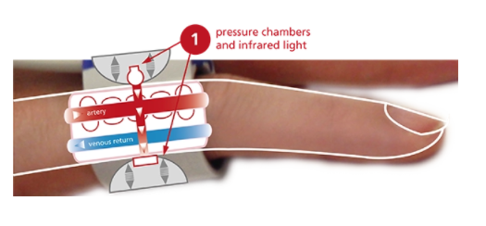
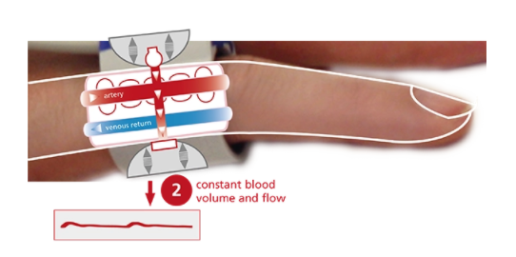
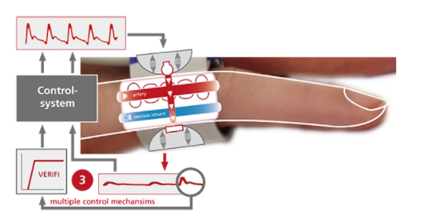
The blood flow in the finger is detected by infrared light sensors.
Pressure is exerted on the artery by inflating or deflating the
integrated pressure chambers in order to “neutralize” blood
pulsation and keep the blood flow constant.
This “counter pressure” which is necessary to keep the blood
flow constant corresponds to the real arterial pressure.
The pressure system is controlled by multiple digital feedback
loops and the patented “VERIFI-algorithm” for high fidelity
signal processing, artifact and vasomotor activity rejection.

Slide 7
Arterial tonometry : technique that involves measuring the speed at which pulses travel within the arterial system and the pressure changes they create. It allows to acquire and analyze important hemodynamic information not possibly obtained with brachial sphygmomanometry.
Pulse Transit Time (PTT) : is the time it takes the Pulse Pressure (PP) waveform to propagate through a length of the arterial tree. The pulse pressure waveform results from the ejection of blood from the left ventricle and moves with a velocity much greater than the forward movement of the blood itself. This pulse transit time (PTT) indirectly depends on blood pressure – the higher the pressure, the faster PTT.

Slide 8
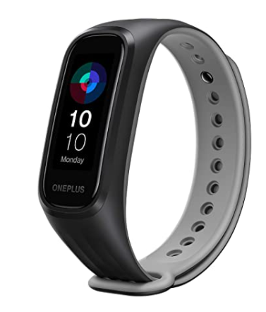
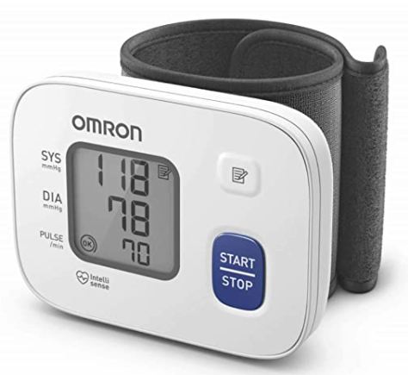
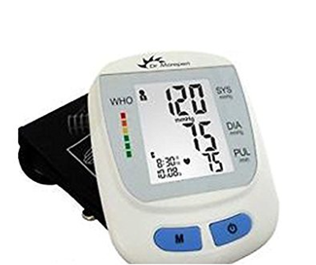
Available devices
OnePlus Smart Band: 13 Exercise Modes,
Blood Oxygen Saturation (SpO2), Heart Rate
& Sleep Tracking, 5ATM+Water & Dust
Resistant( Android & iOS Compatible)
Omron HEM 6161 Fully Automatic Wrist
Blood Pressure Monitor with Intellisense
Technology, Cuff Wrapping Guide and
Irregular Heartbeat Detection
Dr. Morepen BP One BP09 Fully
Automatic Blood Pressure Monitor

